Slide 1
Newsletter 15th September 2017
Friday 12th July
Message from Mrs Horton
This week was transition week at HP! All the children have met their new teaching teams and had some time with them in their new classrooms for September. We have two new teachers joining us in September: Ines Fernandez and Ben Hagan. Both teachers came in for two days to support a good induction into HP, meet with Mr Long, the AHT for KS2 and find out about our systems and planning expectations. They also met with the wider teaching team and of course the children! I am very confident that they will be a great addition to the teaching team and very much look forward to working with them.
We have staff members leaving us this year. We say goodbye to Mr McGearty, (Purple Class) who is moving on to teach in secondary school; Miss Bell (Pink class) is relocating back to Newcastle; Miss Childs (teaching assistant in Lime Class) is looking to pursue a new career outside of education. Mr Cotta (teaching assistant in Cyan Class) is off to further studies in Canada! I am sure you would join me in thanking them all for their great work at HP and wishing them the very best for their new adventures ☺
We still have plenty of events before the end of term. Simba and Nemo are off to Frinton on Tuesday – and we have our Exhibition celebrating the creative outcomes from the ‘Life on the Thames’ theme on Thursday and Friday. I hope to see lots of families at the Summer Fair on Thursday – fingers crossed for the weather! Please do support the fair in any way you can.
Contributions to the Tombola are always welcome ☺
More information from FoHP later in this newsletter.
Lastly, I wish all of our families a wonderful Summer.
We look forward to welcoming the children back on
Tuesday 3rd September 2024.
Upcoming events
Week beginning 15th July
Tues 16th FRINTON for Simba and Nemo
Creative Day for Paddington and Mowgli
Wed 17th Green Class Assembly
Tower bridge online workshop LKS2
Thurs 18th Life on the Thames Exhibition, Summer Fair
Fri 19th Life on the Thames Exhibition
End of Year Reports sent home
Week beginning 22nd July
Tues 23rd Year 6 Leavers Assembly
Wed 24th Last Day of Term – children dismissed 2pm
Life on the Thames Exhibition
The Exhibition will be OPEN to families on Thursday 18th and Friday 19th July.
To help us manage numbers, please try and stick with the following timetable – children from each house will be working as exhibition guides during each house slot.
Thurs 18th 9:30 am – 11:45am – Nemo families
Thurs 18th 1pm – 3:15pm - Paddington families
Open to all during the Summer Fair
Fri 19th 9:30 am – 11:45am – Mowgli families
Fri 19th 1pm – 3:15pm – Simba families
In the Newsletter today:
P1- Message from Mrs Horton, dates; P2- Federation news;
P3 and 4 – Friends Of Hargrave Park; P5 -Frinton 2024;
P6 - Online Safety, Nursery and toddle room vacancies; P7 – September 2024 – Classes; P8 -Handwriting and Presentation;
P9- A message from our SENDCO; P10 - Reading Recommendations;
P11 – A message from Islington; P12 - Community Support and Activities; P13 - Attendance Matters; P14 – term dates 24/25

Slide 2
Newsletter 15th September 2017
Friday 12th July

Slide 3
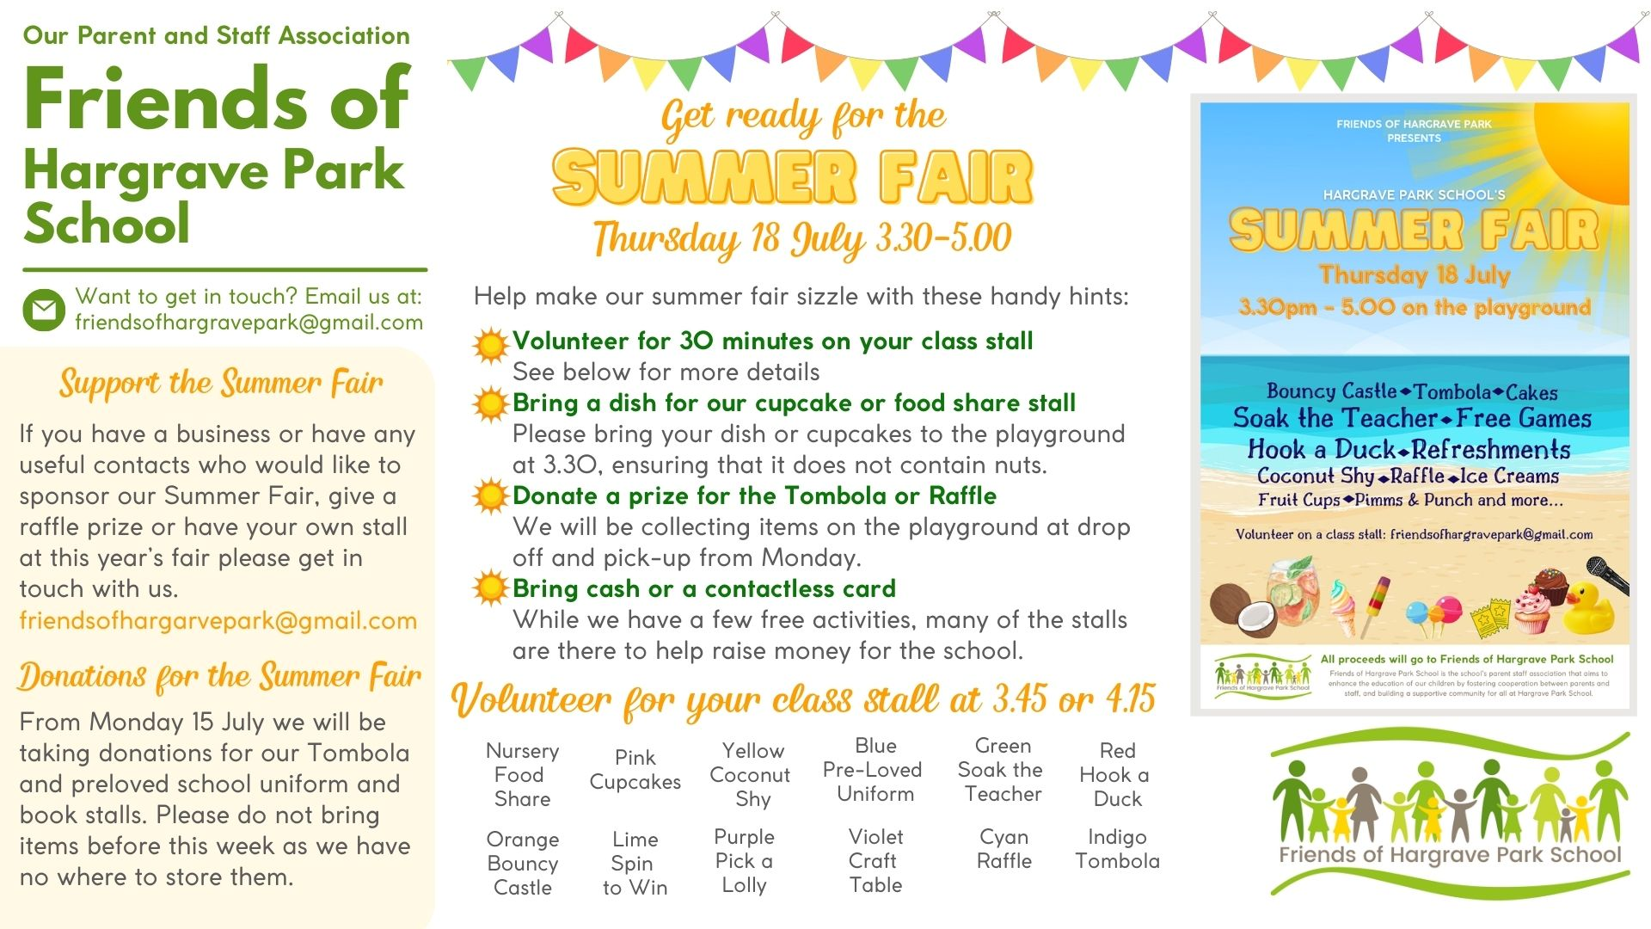
Newsletter 15th September 2017
Friday 12th July
FOHP

Slide 4
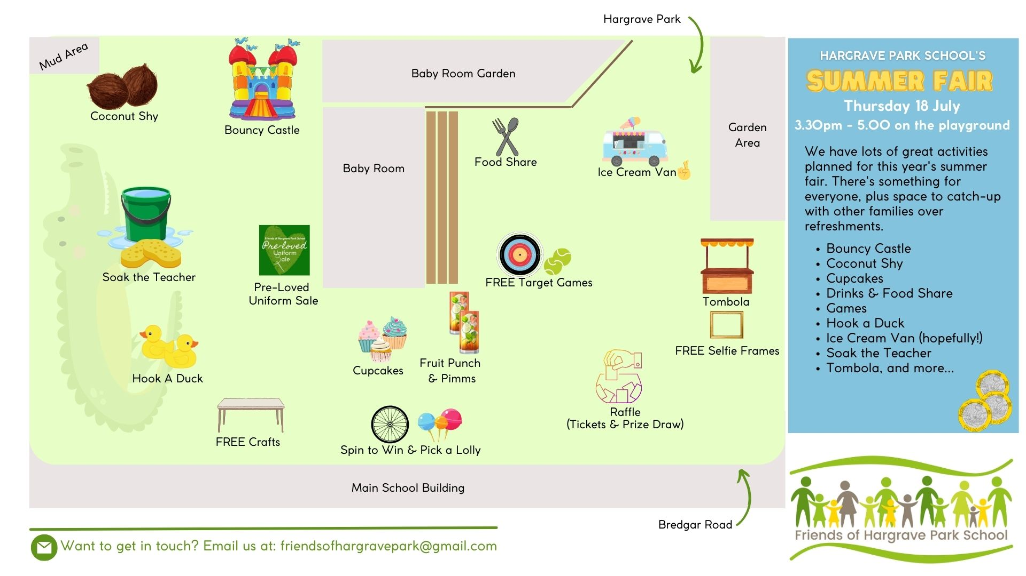
Newsletter 15th September 2017
Friday 12th July
FOHP

Slide 5
#taking pride in our appearance
Newsletter 15th September 2017
Friday 12th July
Frinton 2024
On the day of the Frinton trip, children need to:
Arrive at school between 8am and 8:15am. We will leave at 8:30am.
Wear PE kit to school – with a sun hat and sun cream applied –watch the weather forecast to ensure your child is suitably dressed as we will be outside while we are there.
Bring packed lunch including a bottle of water
Bring a towel and change of clothes in their PE kit bag, plus a plastic bag for wet things.
NB: Children are welcome to bring beach activities – eg buckets and spades. If they choose to bring such items, children must remember that they need to be responsible for all of their own belongings.
We aim to arrive back at Hargrave Park at 5pm. We will keep families updated with any changes.
If you have any questions, please speak to a member of staff on the playground.
Paddington and Mowgli went to Frinton
on Wednesday 10th July.
A good time was had by all ☺
Simba and Nemo will go to Frinton
on Tuesday 16th July.

Slide 6
Newsletter 15th September 2017
Friday 12th July
Online Safety
Time off school in the Summer holidays may mean more time is spent online.
Follow this link to a blog from Childnet with some advice for staying safe online in the Summer holidays.
https://www.childnet.com/blog/staying-safe-online-in-the-summer-holidays/
Some ideas and links from the blog:
Talking about their time online
The holidays are a good opportunity to talk to your children about their online friendships, the sites they use and encourage best practices online.
Watch Red and Murphy talk to Freddie and Alisha about asking before they watch videos online
Read Digiduck’s Big Decision and help educate children aged 3 – 7 about how to be a good friend online
Take the ‘Be the change’ quiz and help 8 – 13 year olds to explore how children and young people share images and videos online
Have an adventure with Kara, Winston and the SMART Crew and help them to make SMART online decisions
Toddler Room and Nursery vacancies for September
Do you know of any families looking for a space for their 2 or 3 year old in September?
We currently have a few spaces left in our Toddler Room and Nursery for September.
Please ask families to email us at parents@hargravepark.islington.sch.uk or pop into the office if they would be interested in finding out more about what we can offer.
Our Assistant Headteacher for EYFS and KS1 will be able to offer families a tour of our provision before the end of term.

Slide 7
Newsletter 15th September 2017
Friday 12th July
Preparing for September!
Yesterday, children visited their new classrooms and met their new class teacher and teaching assistant.
This morning, all children who will be joining Reception in September had a chance to join us for the Reception open morning.
In September, Reception classes will be structured slightly differently: Pink Class will be a class full of Reception children (younger reception children); Blue class will be mixed Reception (older reception children) and Year 1 (younger year 1 children).
Children are grouped according to age as per our current one-and-a-half form entry model. This gives class teachers more opportunity to develop learning which is ‘age and stage’ appropriate. For example, both Pink and Blue Classes will offer continuous provision and regular opportunity for outdoor learning.
Classes and teaching teams September 2024
EYFS and Key Stage 1
Nursery: Carla, Danni, Carolin, Petra
Pink Class – Reception: Nilsu Bulut and Charley Dixon
Blue Class – Reception and Year 1: Georgia Cottington and Ema Gaywood
Green Class – Year 1 and 2: Georgina McNamara and Kulsuma Khanom
Red Class – Year 2: Emily Thomas and Kim Fosbrook
Key Stage 2
Violet Class – Year 5: Sophie Gaston and Lynda Piggot
Cyan Class – Year 5 and 6: Ben Hagan and Lorraine Stannard
Indigo Class – Year 6: Zoe Nadarajah and Pauline Chisolm
Orange Class – Year 3: Jamie Harney
Lime Class – Year 3 and 4: Juliet Makima
Purple Class – Year 4: Ines Fernandez
Orange, Lime and Purple Classes will be smaller and will share Bobbie-Jo Jago and Folami Lawrence as teaching assistants.

Slide 8
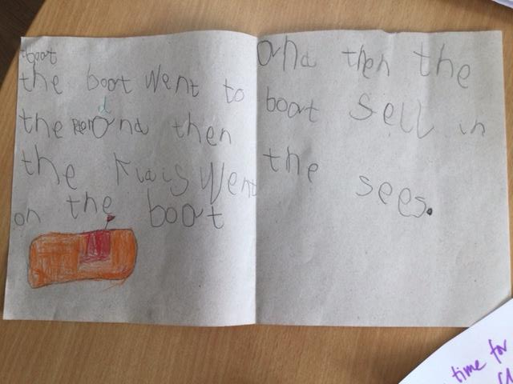
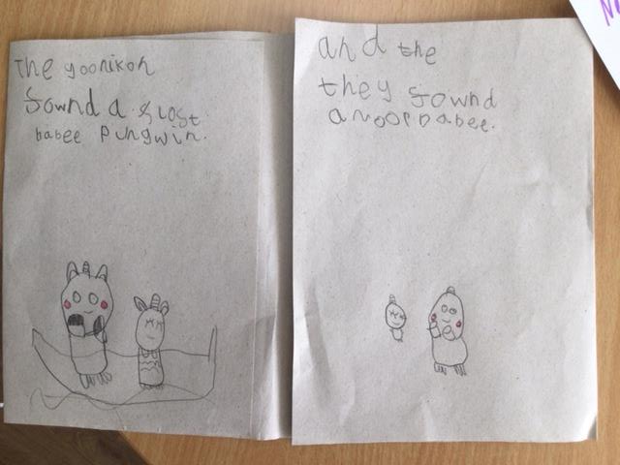
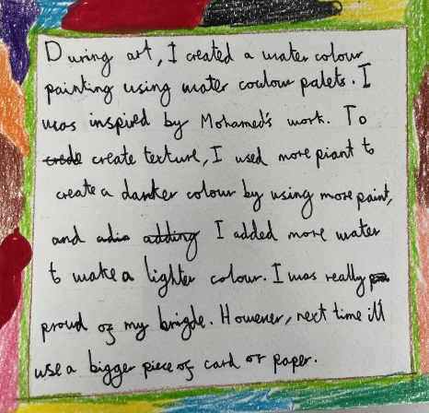
#taking pride in our appearance
Newsletter 15th September 2017
Friday 12th July
Handwriting and Presentation @ HP
Positive Presentation!
At Hargrave Park, we want children to be proud of their work as this feeling is linked with having confidence in themselves as independent, ambitious learners.
Maryam and Zidayne in Reception have been working really hard on sentence writing to produce their own stories!
The language of letter formation!
Did you know we use set language to support letter formation? This week’s letter is E.
E: down and across, lift, across at the top, lift and across in the middle.
e: start near the bottom, go up, around and down!
Practice at home!
The school uses the Nelson Handwriting scheme from Oxford Owl. Take a look at the videos below for tips on practice at home and fine motor warm-up exercises. Encourage children to verbalise what they are doing to understand their thought processes as they write.
https://www.oxfordowl.co.uk/for-home/oxford-owl-videos/handwriting-videos--1/
Baqir in Year 5 has worked so hard on developing his handwriting style and should feel very proud. He now writes both efficiently and legibly!

Slide 9
Newsletter 15th September 2017
Friday 12th July
A message from our SENDCO: Miss D’Orsi
Did you know that how we ask questions is very important?
When we talk to children we often ask them lots of questions to help them develop their thinking and to help them to learn about the world around them. Teachers use questioning as a teaching technique.
A group of researchers - Blank, Rose and Berlin – analysed different types of questions and the level of understanding required by children to be able to answer different types of questions.
The ‘Blank Levels’ of Questioning
The researchers created a framework of 4 different levels of questions, ranging from simple and concrete questions to more difficult and abstract questions. When adults use questioning with children it encourages the development of language and vocabulary, as well as skills in comprehension, reasoning, inferencing, predicting and problem solving.
Here are the 4 ‘Blank Levels’ of questions and some examples:
Level 1: Naming/Labelling
What is this? / Find one like this / What can you see? / Show me the …. / Get the ….. / Pick up the ….
Level 2: Describing things
Find on that is …. ? / What is happening? / Who is …? / What is X doing?
Where is ….? / Finish this sentence …. / What is this for? /
Level 3: Talking about stories and events
What will happen next?/What is …. going to say?/How are these the same?
Level 4: Solving Problems/Justifying
What will happen if we …? /Why did you pick that one? / How did that happen? / What would you do if ….?
You can use the Blank Levels of questioning when talking to your children and see how well they are able to answer questions from the levels. You can also use Blank Levels of questioning when reading with your children. If your child is having difficulty answering question at one level, try asking question one level below.
You can find more information here: https://library.sheffieldchildrens.nhs.uk/what-are-blank-levels/

Slide 10
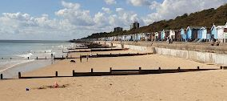
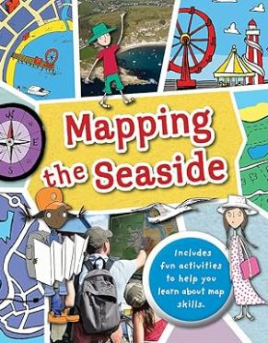
Newsletter 15th September 2017
Friday 12th July
Books themed around the seaside for this newsletter to tie in with the wonderful Frinton trip!
Mo and his friends pack a lunch and head to the seaside for their next running adventure. But what’s that? Could it really be a sea monster? RUN!
Recommended for KS1
Some of the books we have recently enjoyed, which are available from the library:
This book will show you what a bird’s eye map is by looking at aerial photos of a seaside town. How tourist maps can help you find your way around, how to use a compass on the beach
Recommended for LKS2
Winnie is having a ‘whale’ of a time at the seaside but Wilbur hates getting wet. He’d much rather go home. So when Winnie’s broomstick is swept out to sea, will they end up stranded on the beach?
Ro finds school challenging. She knows people think she’s shy. But when she goes to the bay each afternoon to watch the dolphin, she finds strength to keep going. When the dolphin disappears, everything starts falling apart. Can Ro overcome her fears to find him? Recommended for UKS2
Join Lucy and Tom as they discover the seaside. From paddling to picnics, to sandcastles and ice cream
Recommended
for EYFS and Year 1
Please help the school library in returning the borrowed books, so others can enjoy them too.
If books are ‘lost’ please let the school know.

Slide 11
Newsletter 15th September 2017
A message from Islington Friday 12th July
Unlock extra benefits worth hundreds of pounds per child!
If you receive certain benefits, your child could be eligible for so much more than free school meals!
Register before the summer break to unlock:
A £15 supermarket voucher per child, per week – worth £90 per child over the summer break.
Access to the Free Holiday Activities with Food programme (HAF). Book a place for your child at dozens of activities – there’s something for everyone. Every activity includes a free healthy meal.
A £150 school uniform voucher for every child moving up from primary to secondary school.
If you receive benefits and are not yet registered for free school meals, visit our free school meals web page as soon as possible for the best chance of unlocking all the extra support before the holidays.
Once your application for benefits-related free school meals has been accepted, register and book free HAF summer activities.

Slide 12
Community support and activities Friday 12th July
Link:
St Andrews | Meals Network
Link:
islington.gov.uk/lunch-bunch

Slide 13
Attendance Matters
Lets continue our improvement in attendance.
Well done to everyone for trying their best to come in to school every day and on time!
Did you know that Hargrave Park has an attendance target of 96%?
Did you know there are still 10 children who have 100% attendance.
Did you know there are now 107 children with 96% attendance and above?
Did you also know that 72 children have never been late for school?
Congratulations to all of those children – Keep up the good work!
Best Class Attendance
Well done to Lime class They achieved 96.6% this week.
Lime class will be rewarded with a prize for their great efforts.
Best Class Punctuality
Well done to Violet class for being on time and ready to learn 97.5% of the time
Email your appointment letters to: parents@hargravepark.islington.sch.uk
If your child is ill, please call the office on 020 7272 3989 choose option 1 to report your child’s absence
before 8.30am

Slide 14
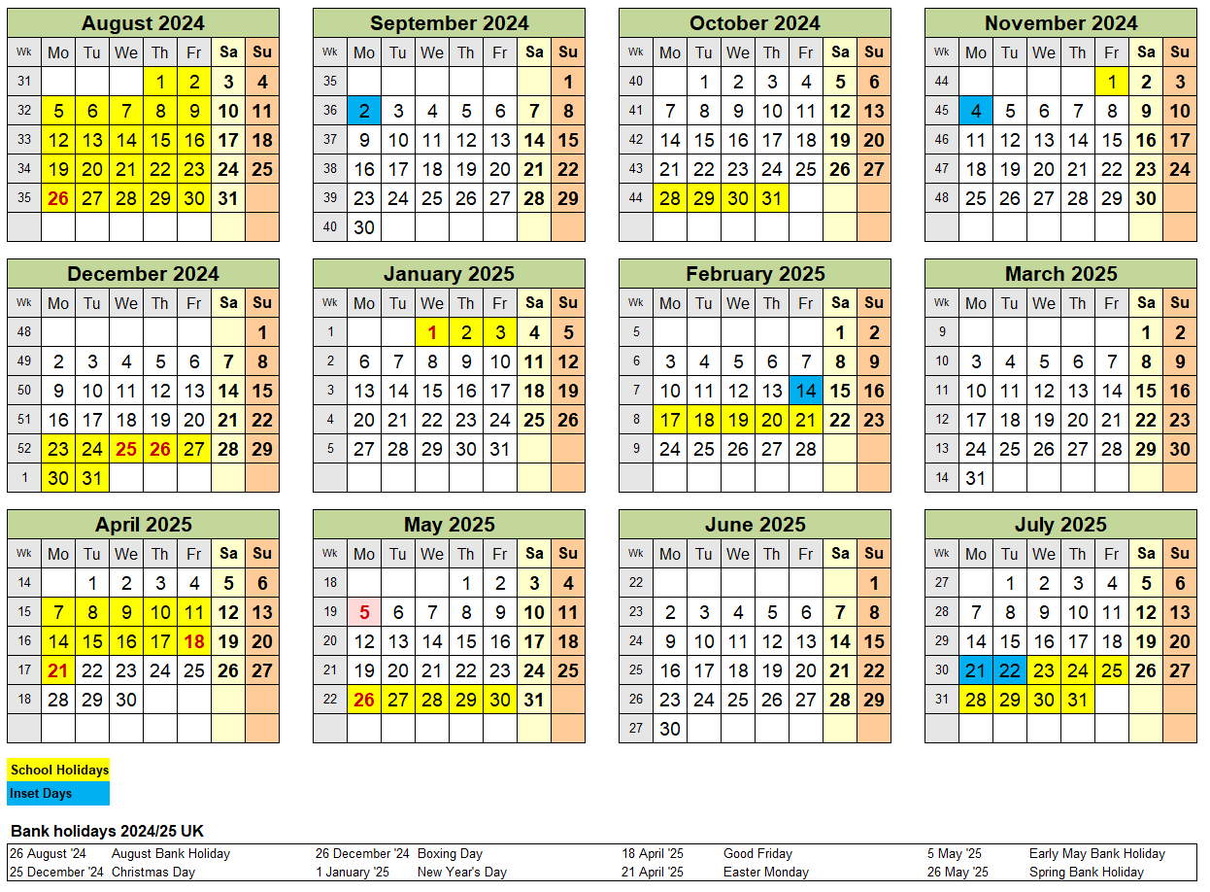
Newsletter 15th September 2017
Term Dates 2024 – 2025 Friday 12th July

