Slide 1
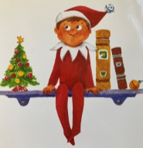
Newsletter 15th September 2017
Friday 1st December
Message from Mrs Horton
Today, we have officially launched the festive season at HP with the return of Sparkles, our Elf on the Shelf. The children were delighted to see his return!
He will be up to all sorts of mischief over the next few weeks I am sure…
There is a lot of information about arrangements until the end of term, so please do keep a close eye on details, times and dates etc
A huge thank you to those parents that are able to support the many trips that are planned. Your efforts are much appreciated!
All families will have received the inspection report for our Under Three Provision – Outstanding in all areas! – a great achievement for the Under 3’s team, brilliantly led by Miss Jones our Assistant Head teacher for EYFS and KS1
We still have some spaces for January 24 in our toddler room. Please spread the word if you can. We are keen for more little ones to join this great provision and get their learning journey started at HP.
My thanks to Friends of HP who are busy with preparations for the Winter Fair. There are lots of ways that families can contribute to its success. (More info further in this newsletter)
If everyone in the community can support in some way – perhaps bringing in something for the class hamper, or something for the tombola . . then it is sure to be a great event with lots of memories for the children.
We have been guaranteed a visit from Santa, so that’s all sorted 😊
Upcoming events
Week beginning 4th Dec
Christmas events will begin this week
see pages 2, 3 and 4
Mon 4th Dec
3:30 – 4pm – Winter cupcake sale
Wed 6th Dec – Red Class Assembly
Wed 20th Dec – Last day of term – 2pm finish
Happy Holidays ☺
Monday 8th January
Children return to school
It’s December now so our very own ‘Elf on the Shelf’ – Sparkles – is back! He is very rarely on a shelf though – today he was on a swing!
Can you spot him hiding in the newsletter…?
In the Newsletter today:
P1 – Message from Mrs Horton; upcoming dates
P2 . P3 – Winter fun – dates and plans
P4 - Friends of Hargrave Park
P5 – Lunch at School; anti-social behaviour
P6 – Online safety
P7, P8 – Attendance Matters
P9 – looking ahead to 2024
Reception Starters 2024
Is your child due to start Reception in September 2024?
We will be having an open morning on 10th January.
Contact the office to book your place.

Slide 2
Newsletter 15th September 2017
Friday 1st December
Theatre Visits
Weds 6th Dec
‘Wow! It’s Night time’
Little Angel Theatre
a.m. Nursery and Yellow Class
p.m. Pink Class and Blue Class
Thurs 7th Dec
‘Charlie Cook’s Favourite Book’
Little Angel Theatre
a.m. Green Class + young HP House
p.m Red Class
Wed 13th Dec
Aladdin
Hackney Empire
p.m KS2
NB KS2 will return at approx 5pm
Winter concerts
Mon 11th Dec at 3pm
Nursery families invited
Christmas sing-along in the Nursery
Tues 12th Dec at 3pm
Under 3s families invited Christmas sing-along in the toddler room.
Thurs 14th Dec
Winter concerts
Middle Hall
Families invited
9:15am – Reception
1:30pm – Key Stage 1
2:15pm – Lower KS2
3pm – Upper KS2
Winter fun!
Christmas Dinner
Christmas Jumper Day
Fri 15th Dec
Children will enjoy a traditional Christmas dinner at lunch time, wearing Christmas jumpers and pulling Christmas crackers!
Winter Fair
Tues 19th Dec
3:30-5pm
see p3 and 4 for more details about how you can support this event to be successful
Cinema Visit
Tues 12th Dec
Reception to year 6
Holloway Odeon
To see Disney’s ‘Wish’.
watch the trailer

Slide 3
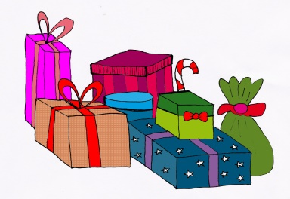
Newsletter 15th September 2017
Friday 1st December
How can you support this event to be successful?
From Tuesday 5th December…
Raffle tickets will be on sale in the playground
From Monday 11th December…
Please bring contributions:
Donate Tombola Prizes – to the boxes in the playground
Donate unwanted gifts for the gift stall – to the boxes in the playground
Donate Raffle Prizes – to playground boxes or directly to the parent volunteers
Contribute to the class hamper – items can be taken to class
On the day – Tuesday 19th December…
Donate cakes for the cake stall
Come along and join in the fun!
Winter Fair
Tues 19th Dec
3:30-5pm
The school works alongside the parent volunteers – Friends of Hargrave Park – to coordinate this favourite event which will offer food to eat, games to play, items to buy and of course a very special visitor…
The success of the Winter Fair depends on support from our families.

Slide 4
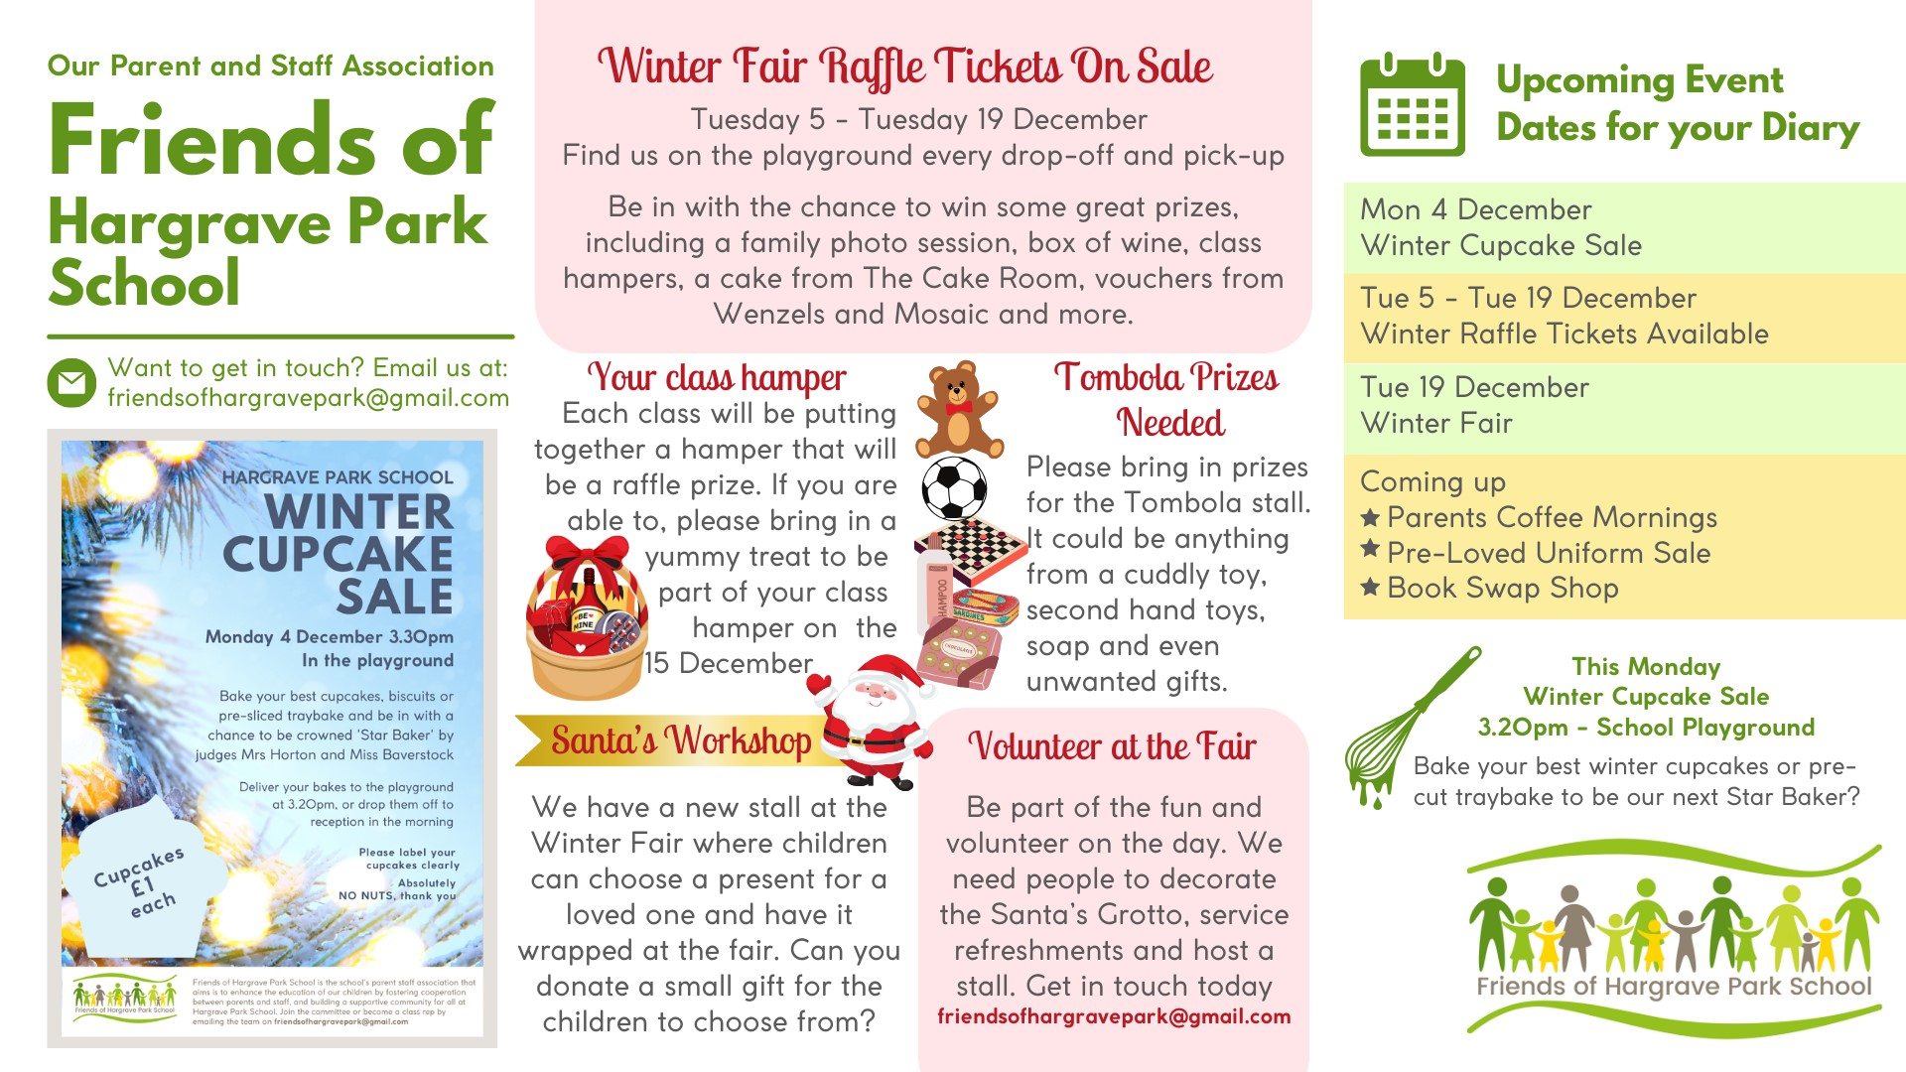
Newsletter 15th September 2017
Friday 1st December
FOHP

Slide 5
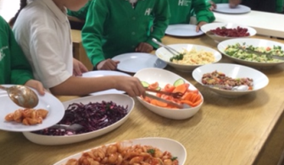
Newsletter 15th September 2017
Friday 1st December
Lunch at School
A good lunch is an important part of the school day.
It is an opportunity to try new things, and eat a range of freshly prepared, healthy and nutritious food. We work closely with Caterlink – our school meal providers – who share that belief. We have a salad bar, a range of fresh vegetables, and fruit every day.
Antisocial behaviour:
please let us know!
A number of our parents have raised concerns regarding anti-social behaviour that they and their children have witnessed on Bredgar Road and Hargrave Park.
There is a concern that it may have a negative impact on our community and lead to families and children feeling unsafe as they travel to and from school.
The behaviour does not directly involve anyone from our school community, but we are able to report our concerns to our governors, our Safer Schools Officer and local councillors.
If you have witnessed any anti-social behaviour near the school that has caused you concern, please do let us know so we can gather a full picture of concerns before sending our reports to the relevant authorities. This will enable us to work more fully in partnership to seek solutions and agree on actions.
Everyone in our community has the right to feel safe and happy.
When children have a packed lunch, it should also be an opportunity to eat a range of freshly prepared, healthy and nutritious food.
Here is a video from the British Nutrition foundation – a guide to create a healthy packed lunch
Yes ☺
Sandwich, pasta, wrap, tortilla, fresh fruit, dried fruit, carrot sticks, cucumber sticks, yogurt, plain biscuit, plain cake eg malt loaf
No ☹
Crisps, chocolate biscuits, chocolate, sweets, cookies, sugary drinks, sugary cakes eg doughnut

Slide 6
Newsletter 15th September 2017
Friday 1st December
Online safety
As the weather gets colder, we are all more likely to spend more time indoors and on our devices.
Having regular open conversations is one effective way of supporting your child online.
Please see the link below to a ‘topic generator’ to help start the conversation.
Questions to start a conversation about life online
One interesting question it generated was ‘Does using the internet help or hinder your friendships?’
saferinternet.org.uk guide-and-resource for parents-and-carers
More Top Tips for Staying Safe Online:
Be curious about what your child does online. If your child uses Snapchat, Instagram, TikTok or any other social media platforms, there is a chance they also use third party companion apps which contain inappropriate material.
Monitor use of social media. Have set times where your child is allowed to use their phone or electronic device.
Check browsing history on devices.
Play together, help set healthy limits. Actively find a variety of activities for children to consume online. Show an interest and join in so you can talk to your child about their gaming and online activity in an informed way.
Ensure parental controls are active and up to date. See links for support:
saferinternet.org.uk parental-controls-offered-by-your-home-internet-provider
saferinternet.org.uk - parental-controls

Slide 7
Attendance Matters
Supporting your child's attendance
Best Class Attendance
Well done to Lime class for achieving the highest attendance last week, achieving 98.7%
Lime class will be rewarded with a prize for their great efforts.
Cyan class were second with 97.7%
At Hargrave Park School we believe that good attendance is vital for children’s :
Learning and progress, Academic achievement, Mental Health and wellbeing, and personal, social and emotional development

Slide 8
Supporting your child’s attendance
Your child can attend school with…
If your child has been diagnosed with the following:
Chicken pox – Child can return to school once all spots have crusted over
Diarrhoea and vomiting – can return to school 48 hours from the last episode of diarrhoea or vomiting
Influenza (flu) – Children should return to school as soon as they have recovered
German Measles (Rubella) – Keep off of school for 6 days from onset of rash
Impetigo – Keep off of school until lesions are crusted/healed, or 48 hours after starting antibiotic treatment.
Measles – Keep child off of school for 4 days from the onset of rash
Mumps – Keep off of school for 5 days from onset of swollen glands
Scabies – Child can return after first treatment
Whooping cough – 5 days from starting antibiotic treatment, or 21 days from onset of illness if no antibiotic treatment has been given.
Doctors notes will be required for all of the above
Toothache
Earache
Headache
Sore throat
Conjunctivitis
Glandular Fever
Head lice
Molluscum Contagiosum (viral skin condition)
Ringworm
Threadworm
Warts and Verrucae
Cough/Cold – If your child has asthma, remember they may need their blue inhaler more often
Hand, Foot and Mouth
Appointments to be made after school
Medication in School
Your child does not need to be kept at home, just because they are taking medication. If your child needs to take prescribed medication during the school day, please complete the medical consent form which can be found on the Piota app
Bumped Heads
If your child has bumped their head, you will only be called if your child complains of feeling sick, dizziness and/or headache. A message will be sent home via text or email informing you if they did bump their head during the day
37.5
A raised temperature is over
Please make sure that all contact details are up to date in case your child is not well enough to stay in school.
Email your appointment letters to: parents@hargravepark.islington.sch.uk
If your child is ill, please call 020 7272 3989 choose option 1 to report your child’s absence

Slide 9
Newsletter 15th September 2017
Friday 1st December
Looking ahead to 2024…
Week beginning 15th January
Orange Class daily swimming lessons
Climate Change for Kids project continues with the Garden Classroom
https://www.thegardenclassroom.org.uk/
Lots is already planned for the Spring term, including:
Week beginning 22nd January
Lime Class daily swimming lessons
Key Stage 1 educational visits to ‘The Toy Project’
https://thetoyproject.co.uk/
Week beginning 29th January
Online Safety week
Week beginning 5th February
Children’s Mental Health week
https://www.childrensmentalhealthweek.org.uk/
Safer Internet Day
www.saferinternetday.org

